Slide 1
Practical Tips for Finding, Training and Keeping Quality Insectary Workers
Angela Hale
Entomologist/Consultant
Biobest Biological Systems
Richard Ward
Director of Business Development
Beneficial Insectary

Slide 2
Outline
Introduction and background
Hiring and firing
Unique qualities for insectary staff
Health and Safety
Retention, rewards and continuing education
Q &A

Slide 3
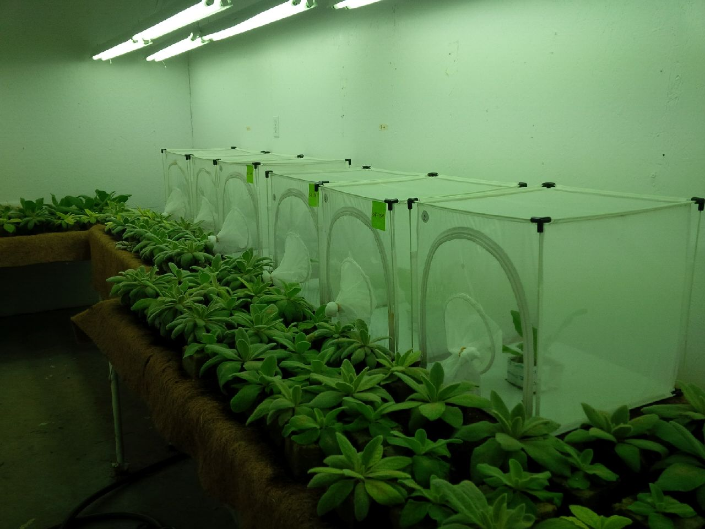
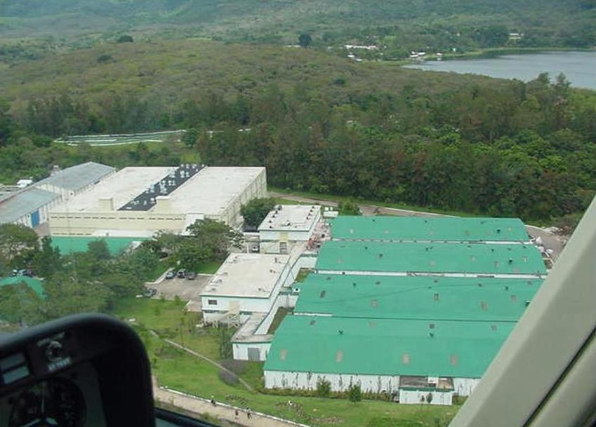
Scale of Production
Lab rearing
Low tech- tri-trophic
High tech-factitious prey or artificial diet
Factory scale mass-production of sterile insects

Slide 4
Reference
Principles and Procedures for Rearing High Quality Insects
John C Schneider, Editor
Copyright 2009 MSU
(Chapter 3, The Insectary Manager
William R Fisher)

Slide 5
Hiring: Education and Experience
Level of education depends on position to be filled
Passion, commitment and reliability more important than education
Mass-Rearing workshop graduates
Entomology, horticulture, university co-op
Must have a ‘feel’, sixth sense, ‘green-thumb’
Cook, food processing, livestock
Not be scared or repulsed by insects and spiders!

Slide 6
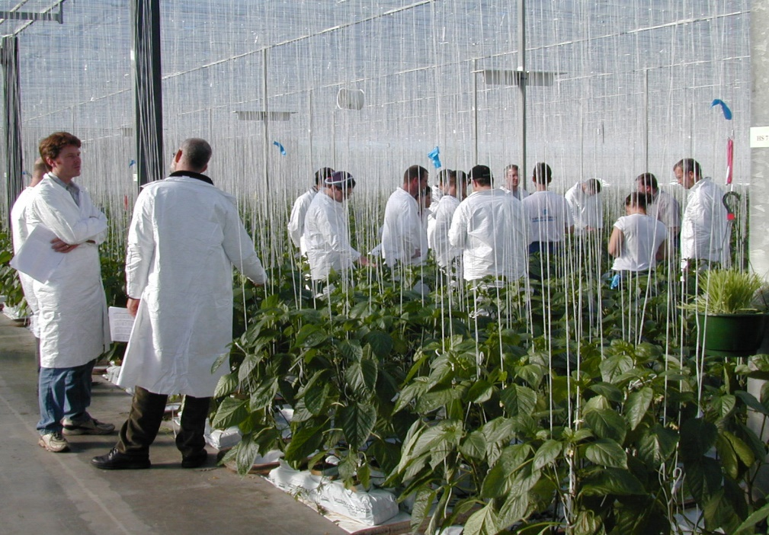
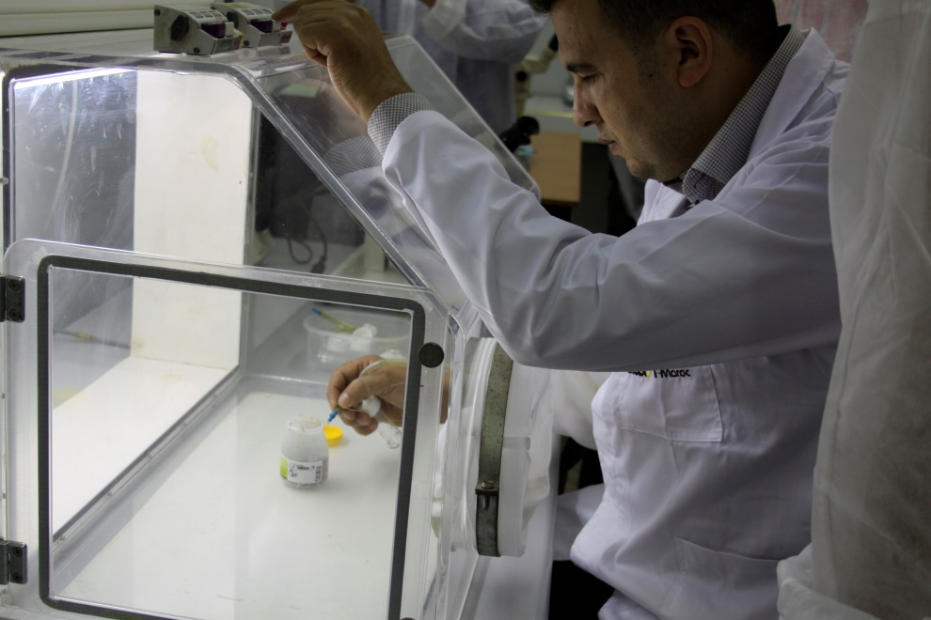
Training
Buddy system
Standard Operating Procedures (SOP)
Study Groups
Workshops
Meetings

Slide 7
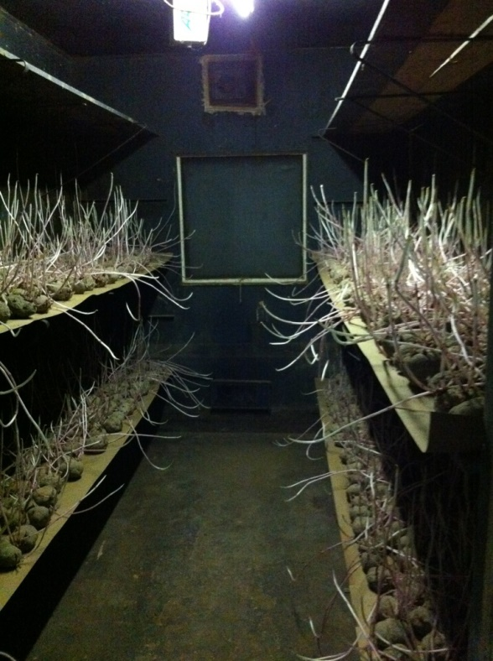
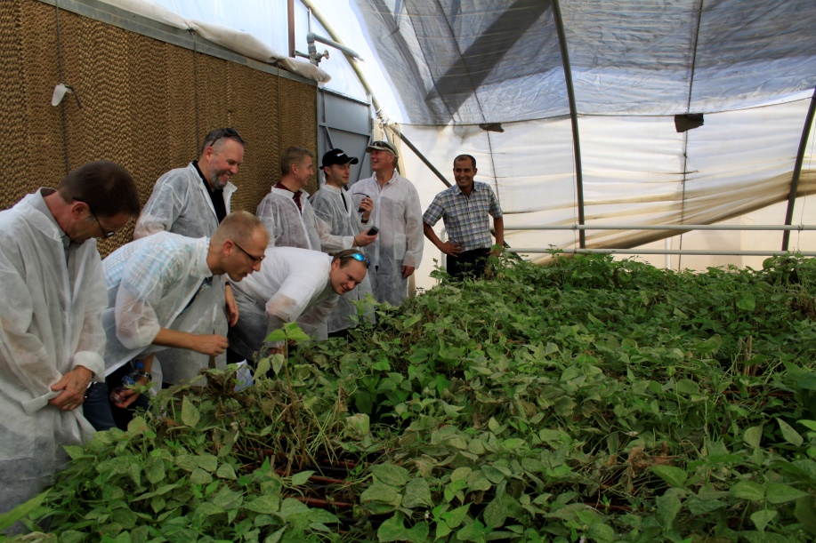
Climate and Communication
Temperature
Relative Humidity
Air Circulation
Disease prevention
Avoid contamination

Slide 8
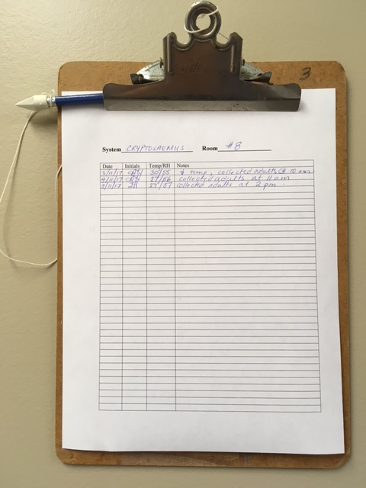

Slide 9
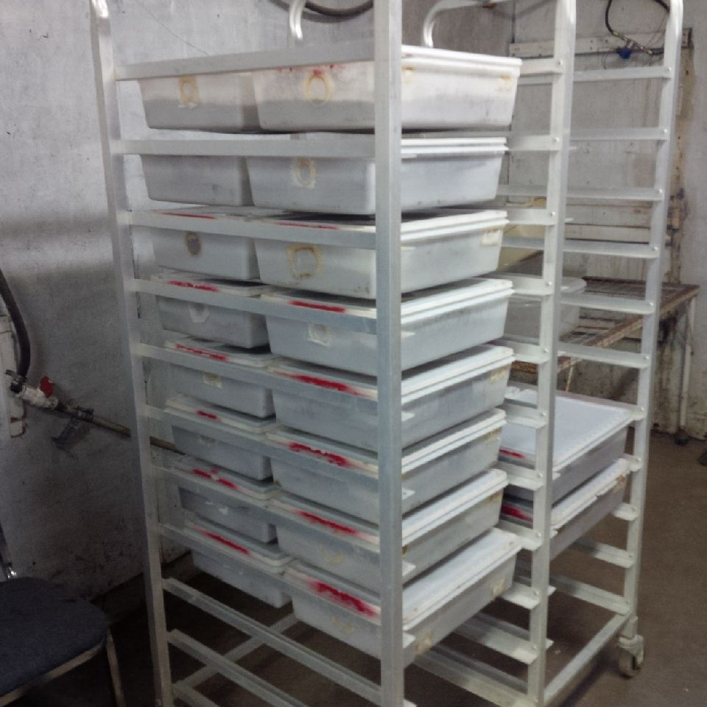
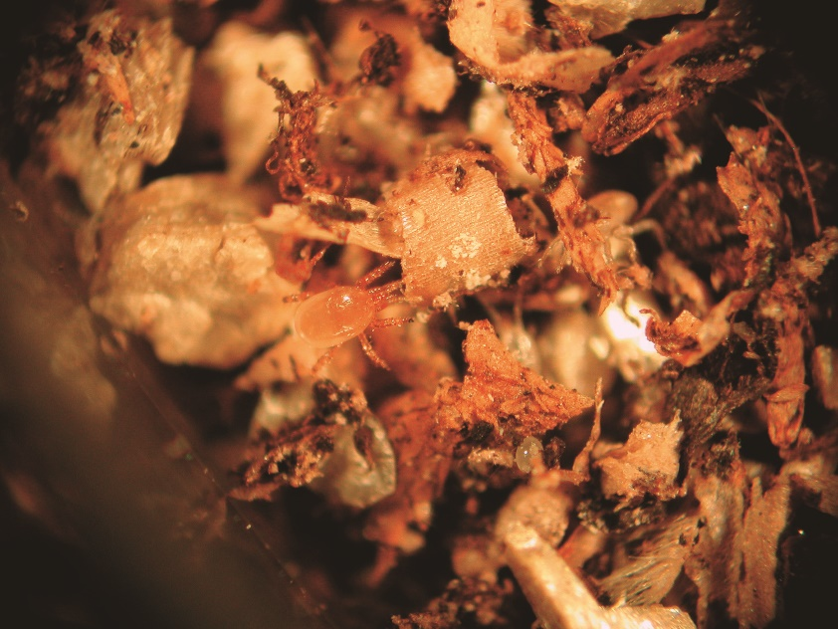
Training Tools
SOP
Maps/Signage
Tyvek Suits
Moats/Footbaths
Showers
Change of Clothing

Slide 10
Health and Safety
General
Allergens- bee stings, bites, rashes from mite hairs, respiratory problems
Pathogens-fungal spores
Dust masks, respirators, protective clothing, eyewash stations
Monthly safety meetings (good time to get together and discuss general issues at the same time)

Slide 11
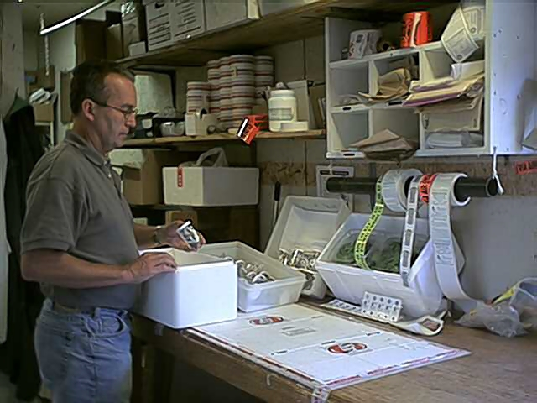
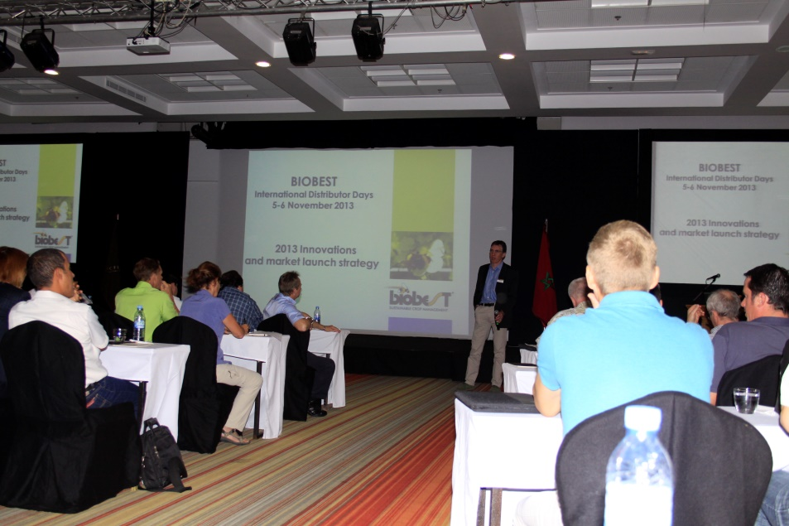
Team Building
Job shadowing to understand how each position is important
Cross-training
Education
Recreation
Benefits

Slide 12
What can go wrong?
Smart phone/social media
Poor work ethic
Poor skills, no ‘feel’ for insectary work
Micro-management with no flexibility
3 month probationary period useful

Slide 13
Positive Work Environment
Pride in a job well done
Belief in value of type of employment
Bonuses based on company performance
Health Benefits
Fun events, annual awards

Slide 14
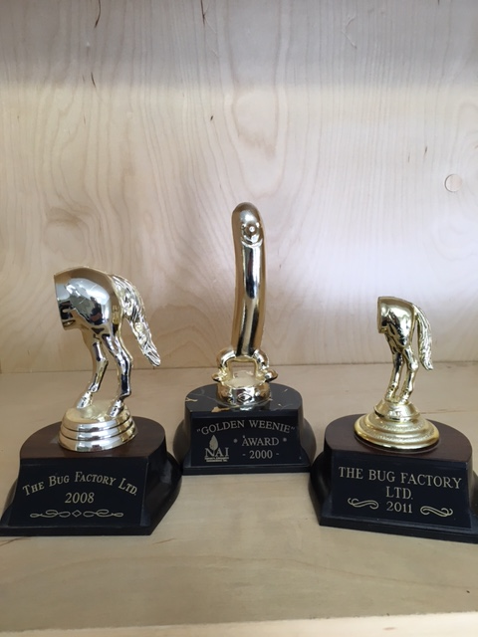

Slide 15
In Summary:
Hire slowly, fire quickly
Take time to train well
Encourage and support continuing education
Team build and reward individual and company performance
Ask questions and listen!

